Slide 1
MVC Views & Layout
from Microsoft: Adding a View
Microsoft Virtual Academy (MVA): Bootstrap
David Turton
Conestoga College
Institute of Technology and Advanced Learning
dturton@conestogac.on.ca
Doon 2A605 x3610

Slide 2
Objectives
Identify the View used by a Controller action
By convention
Forcing a non-conventional selection
Pass data to a View in ViewBag or ViewData
Dynamic properties, any datatype
Pass a strongly-typed Model in ViewData
A case for View models
Generate Views for a Controller's actions
Predefined scaffold templates
Use the Razor Engine
Conventions: @ symbol, HTML encoding, etc.
Specifying & using layouts (aka master pages)

Slide 3
Purpose of a View
Defines the UI (web page) for the user
Controller provides data to the view
View is rendered into HTML5 for the browser
Receives data from the user
And passes it to a Controller action
You can't just display a View
It's always rendered by a Controller
Just to muddy the waters:
Views can render content other than HTML …

Slide 4
Aside: Anchor Tag Helpers
http://www.davepaquette.com/archive/2015/06/01/mvc-6-anchor-tag-helper.aspx

Slide 5
Modify the Default Layout's Menu - so we can easily get to StoreController's Sample action
@{
Layout = "_Layout";
{
First, locate the default layout
Identified by ~/Views/_ViewStart.cshtml
…so the default layout is ~/Views/Shared/_Layout.cshtml
Locate the menu code:
<div class="navbar-collapse collapse">
<ul class="nav navbar-nav">
<li><a asp-area="" asp-controller="Home" asp-action="Index">Home</a></li>
<li><a asp-area="" asp-controller="Home" asp-action="About">About</a></li>
<li><a asp-area="" asp-controller="Home" asp-action="Contact">Contact</a></li>
</ul>
@await Html.PartialAsync("_LoginPartial")
</div>
The CSS classes display the list horizontally, if the screen is wide enough

Slide 6
Add a link to StoreController's Index action
Using an HTML tag:
<li><a href="/store/index">Browse Store</a></li>
Using an HTML Helper (ASP.NET MVC 5):
<li>@Html.ActionLink("Browse Store", "Sample", "Store")</li>
Using Tag Helpers (ASP.NET Core 1.0):
<li><a asp-controller="Store", asp-action="Sample">Browse Store
</a></li>
All produce the same results.
Parameters: displayed text, action, controller
… later: passed variables & attributes

Slide 7
Why use Tag Helpers over HTML Helpers?
Without this, itemId would be an attribute, not a QueryString variable
HTML Helpers are positional
Misinterpreted if the parameter count's wrong
@Html.ActionLink("Browse Store", "Index", "Store", new { itemId = 3 }, null)
Overriding stock <a> attributes is … different:
@Html.ActionLink("Details", "Details", "Store", new { target="_blank" } )
Tag Helpers use named attributes, not positional ones
Unspecified helpers will default or be ignored
→ You're also inside the <a> tag
So … standard HTML attributes are still there
You can put an anchor around an image

Slide 8
Why use Tag Helpers over stock HTML attributes?
meh … I'm sure there's a technical argument somewhere …
Alluding to programming principles or levels of abstraction
Counterbalanced by abandoned tech like HTML Helpers (after 5 years)
You already know how to write anchor tags
Plugging variables in is not difficult:
<a href="/Store/Edit?itemId=@ViewBag.itemId">Edit</a>
<a asp-action="Edit" asp-route-itemId="@ViewBag.itemId">Edit</a>
Intellisense does help after "asp-", and you can let more things default
If you need to use a Tag Helper, you can't if href= is specified
How about: "Yup, I've used anchor Tag Helpers" at an interview?
… does that sound marketable?

Slide 9
Anchor Tag Helpers – common ones - like HTML attributes, these can be in any order
asp-controller = "Store"
Name of the target controller
…notice: leave "Controller" suffix off when referencing controllers
Required if you're going to another controller in the project
Optional if you're going to an action in the current controller
asp-action = "Create"
Name of the action (method) you want to execute
Optional if you're going to the "Index" action or to the current action
asp-route-xxx = "some value"
Will add a QueryString variable named "xxx" to the URL
If variable's name is "id", will add it as 3rd parameter in URL

Slide 10
Anchor Tag Helpers – less common ones
asp-area = "Products"
Very large sites will have an "Areas" folder
With a sub-folder for each division, containing their controllers & views
"Products" is the name of a sub-folder inside "Areas"
asp-route = "xxx"
This says to use the RouteMap named "xxx" in ~/Startup.cs
asp-protocol = "https"
Default is to use the current HTTP or HTTPS protocol
asp-host = "www.conestogac.on.ca"
Used to override the current web server in the URL
asp-fragment = "namedAnchor"
This adds "#namedAnchor" to the end of the URL

Slide 11
End Aside on Anchor Tag Helpers

Slide 12
Add an Action To StoreController
using System;
using System.Collections.Generic;
using System.Linq;
using System.Threading.Tasks;
using Microsoft.AspNetCore.Mvc;
namespace MvcMusicStoreCore.Controllers{
// display music available for users to add to their shopping cart
// D. Turton July 2016
public class StoreController : Controller
{
// sample action for View examples
public IActionResult Sample()
{
ViewBag.message = "this is the ViewBag property 'message'";
return View("Sample");
}
// GET: Store
public IActionResult Index()
{
IActionResult … means the result of this method will be an action for the framework to perform … like fire up a view or redirect to another action.

Slide 13
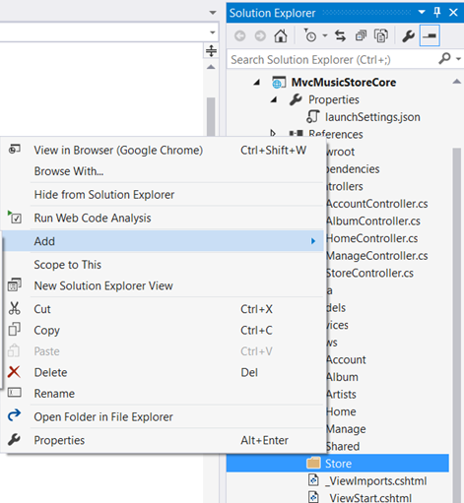
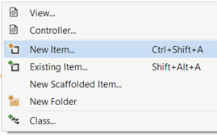
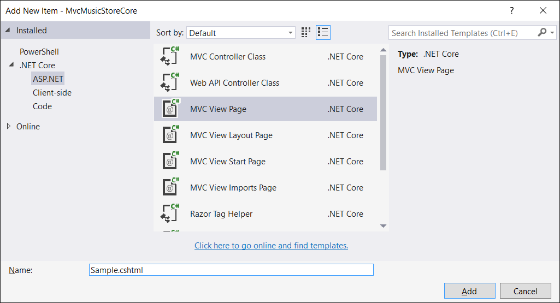
Generate a View for the Action Convention: place it in ~/Views/Store … because it's for StoreController
Add→View wants to produce a templated view
We're using New Item→View Page to get a blank one
Convention: name the page the same as the action

Slide 14
Manually Type View Content
@{
Layout = null; // skip the default layout (master page)
}
<!DOCTYPE html> <!--tell browser this is using HTML5-->
<html>
<head>
<title>Sample View</title>
</head>
<body>
<h1>@ViewBag.Message</h1> <!--pick a value from ViewBag-->
<p>
This is a sample view that doesn't use the standard site
layout. It's not much, but you can see a controller field
passed in the above heading
</p>
</body>
</html>
"@" … is a call to the Razor engine to execute C# code, generate HTML or retrieve a value from ViewData & ViewBag
Is it me, or did anyone else notice that property names in ViewBag are not case-sensitive?

Slide 15
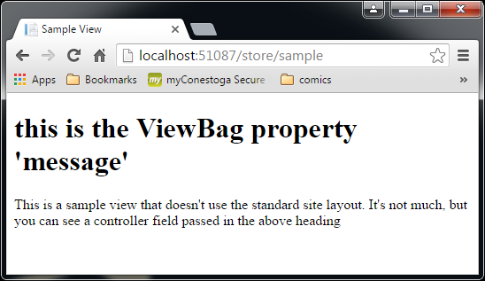
Result

Slide 16
Action→View Convention
public IActionResult Sample()
{
ViewBag.message = "this is the ViewBag property 'message'";
return View();
}
Convention:
return View();
Defaults to a View named same as the action
From a sub-folder of ~/Views, named the same as the controller
Partial-Convention:
return View("fred");
Uses View "fred.cshtml" in controller's ~/Views sub-folder.
public IActionResult Sample()
{
ViewBag.message = "this is the ViewBag property 'message'";
return View("fred");
}

Slide 17
Action→View Convention cont’d
…or skip conventions … just wing it
return View ("~/views/examples/wayOff.cshtml");
If not in controller's subfolder under ~/Views:
Need to specify the path from the root of the site (~)
… and to specify the file-type (cshtml)
Why?
You can use MVC to return XML or JSON or a web service …
(other programmers maintaining your code will hate you)

Slide 18
ViewBag & ViewData
ViewData is a ViewDataDictionary object
Contains a collection of term→definition pairs
The collection can be dynamically extended
To create or modify an entry & its value:
ViewData["expiryDate"] = DateTime.Now;
ViewBag is a dynamic "wrapper" on ViewData
Allowing you to use object-oriented dot notation:
ViewBag.expiryDate = DateTime.Now;
Same effect to same variable as the ViewData example

Slide 19
ViewBag shortcomings
ViewData allows spaces in the term (or key)
ViewData["first name"] = "David";
ViewBag.first name → isn't going to work out so well
ViewBag is dynamic
HTML helpers may not like it unqualified
@Html.TextBox("name", ViewBag.Name) will fail
@Html.TextBox("name", ViewData["Name"]) is OK
@Html.TextBox("name", (String) ViewBag.Name) is OK
ViewBag cannot use ViewData's Model property

Slide 20
Class for music albums Namespace – location of class: project.folder … sorta …
namespace MvcMusicStoreCore.Models
{
public partial class Album
{
public int AlbumId { get; set; }
public int GenreId { get; set; }
public int ArtistId { get; set; }
public string Title { get; set; }
public double Price { get; set; }
public string AlbumArtUrl { get; set; }
}
}
… also known as a "model"
… can instantiate objects of this class.

Slide 21
Add an action to pass a complex object
This code creates a ViewBag/ViewData entry
→ a collection of objects of the Album class:
// return a collection of generic album titles
public IActionResult List()
{
List<Album> albums = new List<Album>();
for (int i = 0; i < 10; i++)
{
albums.Add(new Album { Title = "Generic Album " + i });
}
ViewBag.Albums = albums; // create new entry in ViewData
return View(); // render ~/Views/Store/List.cshtml
}
"List" is probably a
bad action name

Slide 22
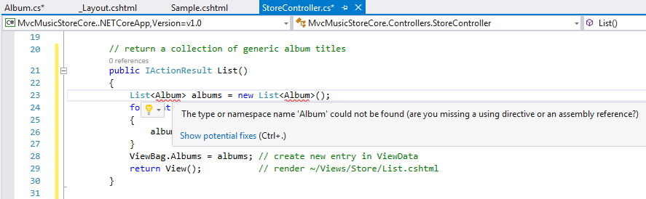
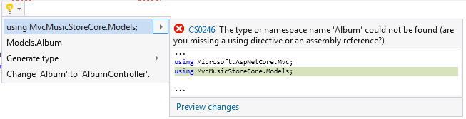
Little problem … it can't find the Album model
Open the light-bulb for suggestions … pick one
It cannot find the Album class because its namespace is not in the search sequence …
→ there's no "using" statement for Models … and Album's not explicitly qualified

Slide 23
Create a View called "List" to display a collection
@using MvcMusicStoreCore.Models;
@{
ViewBag.Title = "List";
}
<h2>Albums List:</h2>
<ul>
@foreach (var item in (ViewBag.Albums as IEnumerable<Album>))
{
<li>@item.Title</li>
}
</ul>
Without the "using" clause, must qualify each reference to the "Album" class:
@foreach (var item in (ViewBag.Albums as IEnumerable<MusicStore.Models.Album>))
A variant will become whatever you put in it:
an object of the Album class, in this instance

Slide 24
IEnumerable<Album>?
You need to declare ViewBag.Albums' datatype
It was created as List<Album>
IEnumerable is an Interface
It declares the object has certain characteristics:
"This is a collection you can sequentially step through"
Most collections implement this interface
Why IEnumerable<Album>, not List<Album>?
We will come across unusual collections: LINQ queries
Or we may change the collection type: Album[]
IEnumerable<> is common to most of them
List<> will only work with one

Slide 25
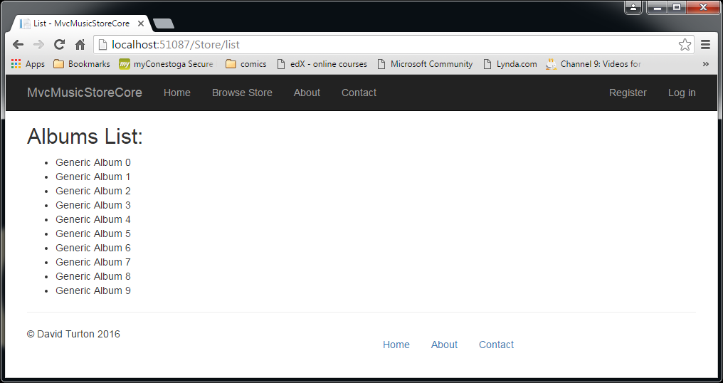
Result

Slide 26
Note on Namespaces
You sometimes need to qualify the classes:
List<Models.Album> albums = new List<Models.Album>();
@model IEnumerable<MvcMusicStoreCore.Models.Album>
Add "using" statements to add them to the search sequence:
In code: using MvcMusicStoreCore.Models;
In HTML: @using MvcMusicStoreCore.Models;
Can now refer to classes without qualifying each reference

Slide 27
Using Model property of ViewData → to use Strongly-Typed Views
ViewData has one "Model" Property
In addition to its dictionary collection
You declare it by passing it from the controller:
// return a collection of generic album titles
public IActionResult List()
{
List<Album> albums = new List<Album>();
for (int i = 0; i < 10; i++)
{
albums.Add(new Album { Title = "Generic Album " + i });
}
return View(albums); // default to ~/Views/Store/List.cshtml
}
Because "albums" is not a string, it's assumed to be the ViewData.Model, and not the name of the view

Slide 28
Declaring & accessing a model in the view
@model IEnumerable<MvcMusicStoreCore.Models.Album>
@{
ViewBag.Title = "List";
}
<h2>Albums List:</h2>
<ul>
@foreach (var item in Model)
{
<li>@item.Title</li>
}
</ul>
Declare the model once and it now knows everything about its properties
Intellisense will help you with it from now on
Declare it as a "model" with a small "m"
Use it as object "Model", with a capital "M"

Slide 29
ViewBag properties or Strongly-Typed View?
When you generate views for a controller using a template
You must specify a model class
Why?
Razor will create all of the input fields for you
It knows what's a date, number, drop-down, checkbox
It’s "strongly typed", remember?
It will map model data to input fields
It will perform field validation & edits
If the data passes the model's edits:
The model is used to modify the database
Notice anything? You don't write code to move data field-by-field, you didn't do DataType checks or construct the SQL …

Slide 30
View Models
You will have one model for each data table
So can have a collection of Album objects in the shopping cart
Sometimes the view needs ancillary data:
User name & authentication level, cart total, etc.
Could put these in ViewData or ViewBag
But … intellisense won't help you with these
Could write a custom model, just for the view
Then the data is strongly typed in the view
Intellisense will be able to help

Slide 31
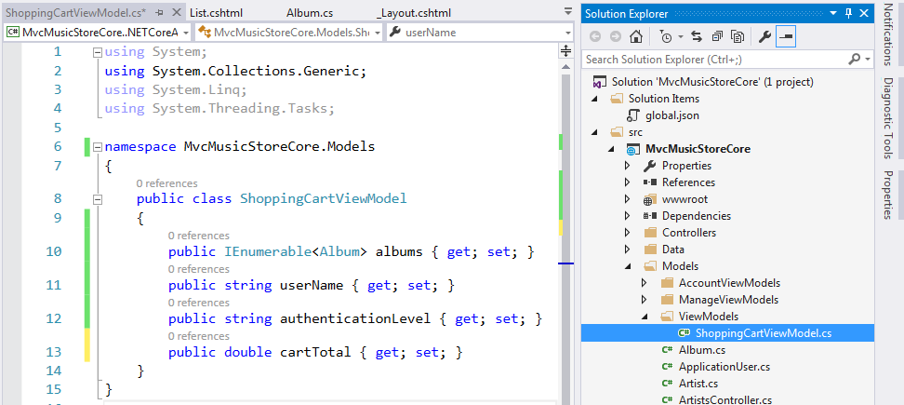
View Model → create a new class
I'm using a sub-folder in ~/Models to organise the model classes
The actual class code says it's in the ~/Models namespace: I manually removed reference to the sub-folder
- Conventions can find it and I only need one "using" qualifier to find all models
No sub-folder in namespace
In View, use:
@model ShoppingCartViewModel

Slide 32
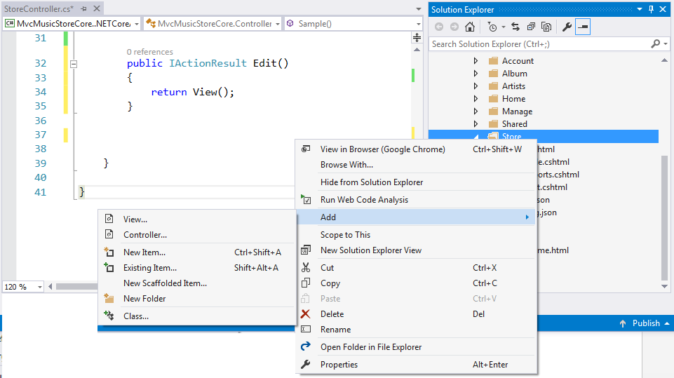
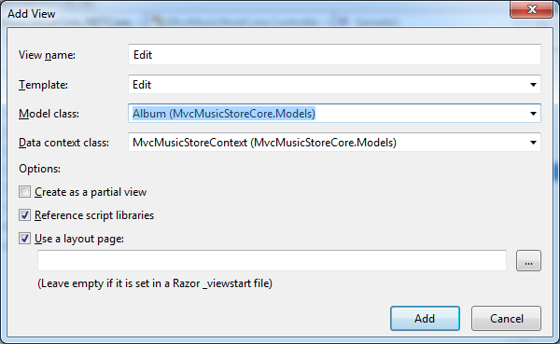
Adding a View
You can code these manually
File extension .cshtml to designate it uses C#
Or right-click the controller's view folder
To get the Add View dialogue
Name the view the same as the action
Choose a template:
Create, Delete, Details, Edit, List
Generates HTML for the required functionality
Identify the model and context
Will generate the @model statement

Slide 33
"Add View" dialogue options
View name
Convention: same as controller action
Template (for scaffolding)
Will pre-build web page for create, edit, list, etc.
Based on the given model
You can define your own templates
You can modify the resulting view

Slide 34
View: Scaffold Templates all templates except List expect a single instance of the model
Create
Form to create a new instance of the model
Label, input and error fields for each property in the model
Delete
Form to delete an instance of the model
Label and display field for each property in the model, except key
Details
Displays an instance of the model
Label and display field for each property in the model, except key
Edit
Edit an existing instance of the model
Label, input and error fields for each property in the model, except key
List
Table displaying records (instances) from the Model
One column for each property in the model, except key
… and a column with detail/create/edit/delete links
Note: View is expecting an IEnumerable<ModelType> object

Slide 35
Razor View Engine
The Razor engine determines:
The syntax used inside the view
How layouts are used
How partial views are used
Razor
Clean/familiar/simple syntax, generates HTML for you
View file extension: .cshtml
…means Razor uses C# syntax … (.vbhtml for VB.NET)
Basic rules:
Write HTML
Type "@" when you want to write code or reference ViewData

Slide 36
"New View" dialogue options cont'd
Reference Script Libraries
Include the JQuery Validation libraries?
Edit/Create need these for field validation
Other views will ignore it.
Create as Partial View
Doesn't use a layout (master page)
Doesn't have <html> or <head>
A partial view is meant to be inserted into another view
Use Layout
Clear checkbox:
Self-contained page with <html>, <head>, <body>
Checked:
Razor engine will use default layout … but can specify another

Slide 37
Razor
Understands the structure of C# & HTML
So transitions smoothly from code to markup
Key transition character is “@”
Tells Razor we’re transitioning to C# code
It’s pretty good at knowing when to transition back
Basic transition types:
Code blocks
Code expressions

Slide 38
Sample View w/ Razor syntax
@{
// this is a block of code, using an inline model:
var items = new String[] { "one", "two", "three" };
Layout = null; // don't use a layout
}
<html>
<head>
<title>Sample View</title>
</head>
<body>
<h1>Listing @items.Length items.</h1>
<ul>
@foreach (var item in items)
{
<li>The item name is @item.</li>
}
</ul>
</body>
</html>

Slide 39
Look for “@”
… @items.Length items.</h1>
@ identifies the start of a C# code expression
Razor knows "items" is not a C# keyword
So it assumes it's looking at a variable's name
Don’t need to tell Razor when the code ends
A space character is not part of a C# identifier
So Razor will transition from code back to markup
" items.</h1>" is just HTML markup

Slide 40
What about "@item.</li>"?
"." is a valid part of an identifier
But we intended it as an end-of-sentence period
Razor peeks at the next character
"<" is not a valid part of an identifier
So the "." can't be part of the code: it must be markup
Razor transitions back to markup on the "."

Slide 41
Problem: watch spaces
Razor has a problem with this:
<span class="text-danger">@TempData ["message"]</span>
It realises TempData is a variable
But the space after it is not part of a variable name
So it leaves C# mode and goes to HTML mode
Net result:
System.Web.Mvc.TempDataDictionary ["message"]
It's not recognising ["message"] as an index into TempData

Slide 42
Ambiguity
@{
string baseNamespace = "MvcMusicStore";
}
<span>@baseNamespace.Models</span>
We were hoping to get the string:
<span>MvcMusicStore.Models</span>
But we get a "no property called Models" error
Razor assumed we wanted the "Models" property of the variable "baseNamespace" (standard C# syntax)
Now we need code delimiters … ( ):
<span> @( baseNamespace ).Models</span>
Round brackets after "@" tells Razor where the code starts and ends
Everything after ")" is tacked onto the results

Slide 43
@ Ambiguity … yes, the @ … no, not that @ … the other @
E-mail addresses have "@" & aren't C# code
Razor recognizes e-mail address patterns
And leaves them alone
"escaping" @
Some e-mails aren't recognized as such
Using "@@" escapes the @ "This @ is no longer special"
Razor processes @@ to mean a generic "@" character
But what about code inside a string:
Number_@items.Count → looks like an e-mail
But we wanted "Number_6"
Delimit & force code with brackets: Number_@(items.Count)
"@(" tells Razor to interpret as C# until ")"

Slide 44
@ Ambiguity … Twitter handles
Twitter handles start with "@"
Need to escape these, by doubling the @:
<p>
You should follow @haacked and @jongalloway.
</p>
Should be coded as:
<p>
You should follow @@haacked and @@jongalloway.
</p>
Or: manually hex-encode "@":
You should follow &#64;haacked and &#64;jongalloway.
… like that's easy to remember …

Slide 45
Razor HTML Encoding
Razor HTML-encodes expressions by default
@{ string message = "<script>alert('haacked!'); </script>"; }
<span>@message</span>
Result:
<span>&lt;script&gt;alert(&#39;haacked!&#39;); &lt;/script&gt;</span>
This protects against XSS (cross-site scripting)
Malicious code obtained from nasties
To override HTML encoding, use @Html.Raw()
@{ string message = "<script>alert('haacked!'); </script>"; }
<span>@Html.Raw(message)</span>
Notice message doesn't have an @ symbol because we're already in code mode, and won't shift to markup until </span>

Slide 46
Razor: Code Blocks
@foreach (var item in items) // alternate code
{
string outputLine = $"The item name is {item}.";
<li>@outputLine</li>
}
You can insert blocks of C# code into views:
@foreach (var item in items)
{
<li>The item name is @item.</li>
}
Razor defaults to code mode inside the block statement
It transitions to markup on "<li>"
But it remembers it's in a { code block }
…and transition back to code on the <\li> closer
It'll interpret "}" as code, without an "@"
While inside HTML markup:
Use "@" to resolve identifiers, just like before

Slide 47
C# block statements when to use { and }
Razor knows about C# block statements like:
"foreach", "if" and "using" … so these don't need @{ }
If a line inside the block produces output for the browser
Put it between HTML markup … or use <text></text>
Declaring & setting variables need @{ }
Methods with a void return-type need @{ }
@{ CloseCase(Id); }
Calling generic<type> methods need round brackets
"<" will cause a transition to markup
Use round brackets to identify it all as code
@( SomeMethod<String>( ) )

Slide 48
Text inside code blocks
@if (showMessage)
{
<text>This is plain text</text>
}
……
@if (showMessage)
{
@:This is plain text
}
<text> is cleaner, looks & acts like automatic transition from/to code
… stays in markup mode until closed
@: transitions to markup, but only for the remainder of that line. The next line defaults back to code.
…I can never remember this one…

Slide 49
Commenting-out Code
use @* to *@
To comment out multiple lines of markup and code
Razor will ensure it's not sent to the browser

Slide 50
Layouts

Slide 51
Layouts in Razor
They're like a master page or site template
Contain <html>, <head> & <body>
And the structure common to every page on the site:
Banner, navigation, contacts, footer
Contain placeholders
Your "guest" views provide content for these
May contain named sections
Guest content for special placement or treatment

Slide 52
A simple Layout called BaseSite.cshtml
<!DOCTYPE html>
<html>
<head><title>@ViewBag.Title</title></head>
<body>
<h1>@ViewBag.Title</h1>
<div id="main-content">@RenderBody()</div>
</body>
</html>
@RenderBody()
Placeholder for the content of views using this layout
Since the one layout is used by several views
Each "guest" view can set ViewBag.Title
Used to distinguish one page from another
Browser window title & page heading

Slide 53
A Simple View … that will be hosted inside your layout
@{
ViewBag.Title = "Guest Site";
Layout = "~/Views/Shared/BaseSite.cshtml";
}
<p>This is the guest page's main content.</p>
Layout variable defaults to path specified in "~/Views/_ViewStart.cshtml"
Setting it in a View overrides the default
The HTML contents of this view
Would replace the @RenderBody()
… in the main-content<div> of the layout

Slide 54
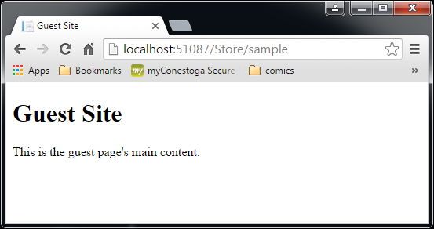
Result
<!DOCTYPE html>
<html>
<head>
<title>Guest Site</title>
</head>
<body>
<h1>Guest Site</h1>
<div id="main-content">
<p>This is the guest page's main content.</p>
</div>
<!-- Visual Studio Browser Link -->
<script type="application/json" id="__browserLink_initializationData">
{"requestId":"e61bb4db9c6849e2ac431945ef075e04","requestMappingFromServer":false}
</script>
<script type="text/javascript" src="http://localhost:63346/477652b629ed4a59aaa39a7ea24e95d5/browserLink" async="async"></script>
<!-- End Browser Link -->
</body>
</html>

Slide 55
Multiple Sections mandatory/optional
<!DOCTYPE html>
<html>
<head>
<title>@ViewBag.Title</title>
</head>
<body>
<h1>@ViewBag.Title</h1>
<div id="main-content">@RenderBody()</div>
<footer>@RenderSection("Footer")</footer>
</body>
</html>
Insert section called "Footer"
This layout will error-out the prior view
Views must supply content for every defined section
Not a nice effect for an existing site
Can make a section optional, using an overload:
<footer>@RenderSection("Footer", required: false)</footer>
This is a named parameter
You could have just entered "false" as a positional parameter
… but this is better-documented

Slide 56
View using a section
@{
ViewBag.Title = "Guest Site";
Layout = "~/Views/Shared/BaseSite.cshtml";
}
<p>This is the guest page's main content.</p>
@section Footer {
This is the <strong>footer</strong>.
}
@section defines the contents for a like-named section in the layout
Have to wonder … why don't I need <text> or @: on that text content?
… a section designates an HTML block, not a code block

Slide 57
Default content for a section
Assume you have an optional section
If a view does not provide content for it
It doesn't exist
What if you want a default content?
There's a "peek" feature available …
<footer>
@if (IsSectionDefined("Footer"))
{
RenderSection("Footer");
}
else
{
<span>This is the default footer</span>
}
</footer>
Code
Also a nice example exploring how Razor transitions between code and markup
markup
Code
markup

Slide 58
Website Templates in MVC
These take advantage of web standards
Like CSS Media Queries
→ what media is the page being displayed on?
HTML & CSS adapt to differing screen widths
For different devices

Slide 59
Default Layout
No need to code, on every page:
@{
Layout ="~/Views/Shared/BaseSite.cshtml";
}
~/Views/_ViewStart.cshtml
Is executed before any view in this folder & sub-folders
It presets the "Layout" vaiable to the default file name
Layout = "_Layout";
Another default: when looking for views:
Controller's folder first, then ~/Views/Shared
Individual Views can override the Layout property
Remember: code on Views is run before HTML is rendered

Slide 60
Partial Views (quick overview) … we’ll go into more detail with “HTML Helpers”
Say a controller has an action like this:
public ActionResult CheckSensors()
{
ViewBag.Message = "sensors online";
return PartialView();
}
Partial Views:
Do not use the default layout from _ViewStart
Do not have <html>, <head> or <body>
They're intended to be inserted into an existing view
Can have their own code and markup
A script, such as one responding to an AJAX call:
Can reload the results of a partial view
Displacing the contents of a <div> currently displayed on the user's browser.
Returns the view called "CheckSensors.cshtml"

